Slide 1
High- Throughput Computing
TASK COMPUTING

Slide 2
Contents
Task Computing
Characterizing a task
Computing categories
Frameworks for task computing
Task-based application Models
Embarrassingly parallel applications
Parameter sweep applications
MPI applications
Workflow applications with task dependencies

Slide 3
Aneka task-based programming
Task programming Model
Developing applications with the task model
Developing a parameter sweep application
Managing workflows

Slide 4
Distributed Computing VS Grid Computing
A computing system in which services are provided by a pool of computers collaborating over a network .----- Distributed Computing
A service for sharing computer power and data storage capacity over the Internet--------- Grid Computing.
Grid computing is a model for allowing companies to use a large number of computing resources on demand, no matter where they are located------------ Grid Computing.
Distributed computing is a subset of Grid Computing.

Slide 5
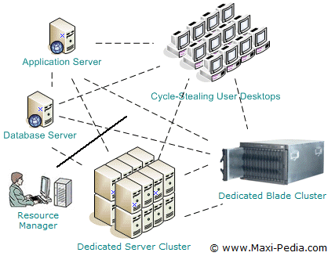

Slide 6
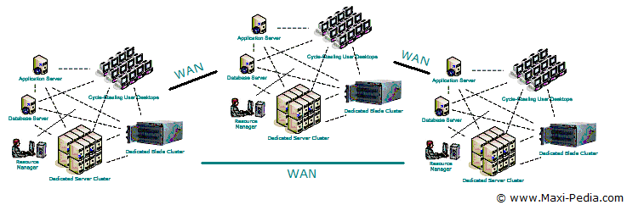

Slide 7
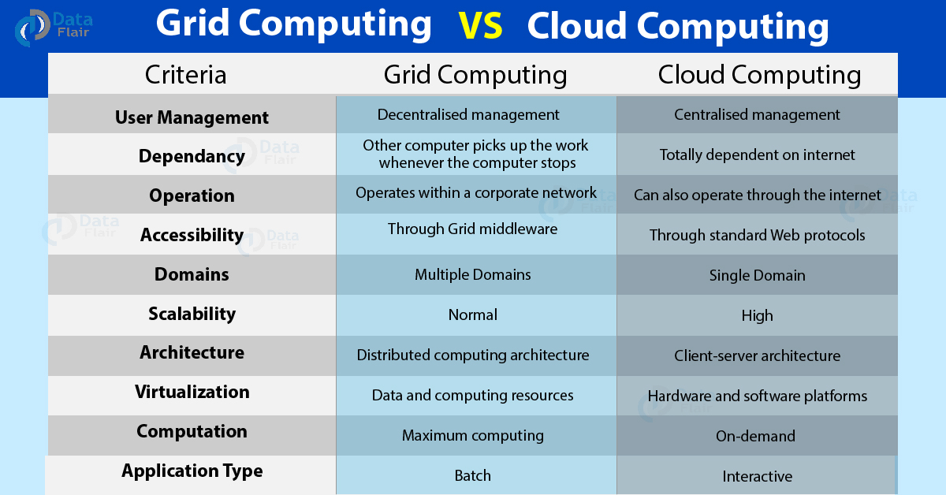

Slide 8
Introduction
A task generally represents a program, which might require input files and produce output files as a result of its execution.
Applications- Collection of Tasks
Task programming =The way tasks are generated,
the order in which they are executed, or
whether they need to exchange data
differentiate the application models.

Slide 9
Task Computing
A task identifies one or more operations that produce a distinct output and that can be isolated as a single logical unit.
A task is represented as a distinct unit of code, or a program, that can be separated and executed in a remote runtime environment.
Programs are the most common option for representing tasks
Multithreaded programming is mainly concerned with providing a support for parallelism within a single machine
Task computing provides distribution by harnessing the compute power of several computing nodes.

Slide 10
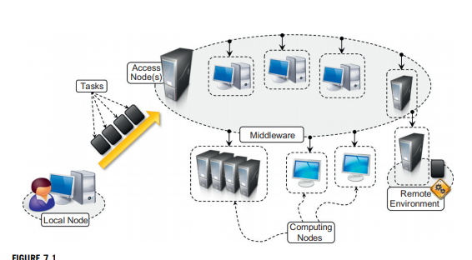

Slide 11
The infrastructures that have been leveraged to execute tasks are clusters, supercomputers, and computing grids.
Now clouds have emerged as an attractive solution to obtain a huge computing power on demand for the execution of distributed applications.
To achieve it, suitable middleware is needed.
The middleware is a software layer that enables the coordinated use of multiple resources, which are drawn from a data center or geographically distributed networked computers.
User submits the collection of tasks to the access point(s) of the middleware, which will take care of scheduling and monitoring the execution of tasks.
Appropriate APIs are also provided to monitor task status and collect their results upon completion.

Slide 12
Middleware provided common operations are:
Coordinating and scheduling tasks for execution on a set of remote nodes
Moving programs to remote nodes and managing their dependencies
Creating an environment for execution of tasks on the remote nodes
Monitoring each task’s execution and informing the user about its status
Access to the output produced by the task

Slide 13
Characterizing a task
A task can be represented by different elements:
A shell script composing together the execution of several applications
A single program
A unit of code (a Java/C11/.NET class) that executes within the context of a specific runtime environment
NOTE:
A task is generally characterized by input files, executable code (programs, shell scripts, etc.), and output files.
In many cases the common runtime environment in which tasks execute is represented by the operating system or an equivalent sandboxed environment.

Slide 14
Computing Categories
According to the specific nature of the problem, different categories of task computing are proposed:
High-Performance Computing (HPC),
High-Throughput Computing (HTC), and
Many-Task Computing (MTC).

Slide 15
High-Performance Computing
High-performance computing (HPC) is the use of distributed computing facilities for solving problems that need large computing power for a short period of time.
Historically, supercomputers and clusters are specifically designed to support HPC applications that are developed to solve “Grand Challenge” problems in science and engineering.
The general profile of HPC applications is constituted by a large collection of compute-intensive tasks that need to be processed in a short period of time.
The metrics to evaluate HPC systems are floating-point operations per second (FLOPS), now tera-FLOPS or even peta-FLOPS

Slide 16
High-Throughput Computing
High-throughput computing (HTC) is the use of distributed computing facilities for applications requiring large computing power over a long period of time.
The general profile of HTC applications is that they are made up of a large number of tasks of which the execution can last for a considerable amount of time (i.e., weeks or months)
Examples of such applications are scientific simulations or statistical analyses.
HTC systems measure their performance in terms of jobs completed per month.

Slide 17
Many-Task Computing
It aims to bridge the gap between HPC and HTC.
MTC is similar to HTC, but it concentrates on the use of many computing resources over a short period of time to accomplish many computational tasks.
The general profile of MTC applications includes loosely coupled applications (distributed memory)
It uses the facilities: Supercomputers, large clusters and emerging cloud infrastructures.

Slide 18
Frameworks for Task Computing
Some popular software systems that support the task-computing framework are:
Condor
Globus Toolkit
Sun Grid Engine (SGE)
BOINC
Nimrod/G
and Aneka.

Slide 19
Architecture is similar to the general reference architecture.
They consist of two main components:
a scheduling node (one or more) and
worker nodes.
The organization of the components of the system may vary.
For example, multiple scheduling nodes can be organized in hierarchical structures.
This configuration is quite common in case of the middleware for computing Grids.
Each of these sites may have their own scheduling engine, especially if the system contributes to the Grid but also serves local users.

Slide 20
Assignment-1: Case Study on Frameworks
Condor
https://research.cs.wisc.edu/htcondor/description.html
Globus Toolkit-
http://toolkit.globus.org/
Sun Grid Engine (SGE)
http://star.mit.edu/cluster/docs/0.93.3/guides/sge.html
BOINC-
https://boinc.berkeley.edu/
Nimrod/G-
http://gridbus.cs.mu.oz.au/papers/cto-gridscheduling.pdf
Aneka.
NOTE: Do case study on above frameworks and submit a report.
( Refer textbook and above links)

Slide 21
What to include in Case Study?
Objective of that framework
How they work?
Identified difference between frameworks if any.
Conclusion: What is the best framework to use?

Slide 22
Task-based application models
There exist several models that are based on the concept of task as the fundamental unit for composing distributed applications.
What makes them different is the way in which tasks are generated, the relations they have with each other, the presence of dependencies, or other conditions.
The most common and popular models based on the concept of task.
Embarrassingly Parallel Applications
Parameter Sweep Applications
MPI Applications
Workflow Applications

Slide 23
Embarrassingly parallel applications
Embarrassingly parallel applications constitute a collection of tasks that are independent from each other and that can be executed in any order.
No communication between each other.
Supported by majority of frameworks like Globus Toolkit, BOINC, and Aneka
Scheduling these applications is simplified and mostly concerned with the optimal mapping of tasks to available resources.
Problems : Image and video rendering, evolutionary optimization, and model forecasting.
Scientific applications constitute a considerable source of embarrassingly parallel applications, even though they mostly fall into the more specific category of parameter sweep applications.

Slide 24
Parameter Sweep Applications
Parameter sweep applications are a specific class of embarrassingly parallel applications.
Parameter sweep applications are identified by a template task and a set of parameters.
Template task - the operations that will be performed on the remote node for the execution of tasks.
The parameter set identifies the combination of variables whose assignments specialize the template task into a specific instance.
Any distributed computing framework that provides support for embarrassingly parallel applications can also support the execution of parameter sweep applications.

Slide 25
The tasks that will be executed are generated by iterating over all the possible and admissible combinations of parameters.
Nimrod/G , Aneka provides- Supported Frameworks
Applications: Scientific computing domain- Evolutionary optimization algorithms, weather-forecasting models, computational fluid dynamics applications, Monte Carlo methods, and many others.
A template task is in general a composition of operations concerning the execution of legacy applications with the appropriate parameters and set of file system operations for moving data.
The template task is often expressed as single file that composes together the commands provided:
Execute. Executes a program on the remote node.
Copy: Copies a file to/from the remote node.
Substitute: Substitutes the parameter
Values-with their placeholders inside a file.
Delete: Deletes a file

Slide 26
The template file has two sections:
Header- definition of the parameter
Task definition section- Shell commands with Nimrod/G Commands.
The Aneka Parameter Sweep file defines the template task.
The file is an XML document containing several sections, the most important of which are shared files, parameters, and task.
Two different types of parameters are defined: a single value and a range parameter
The shared files section contains the files that are required to execute the task;
Task specifies the operations that characterize the template task.

Slide 27
MPI applications
Message Passing Interface (MPI) is a specification for developing parallel programs that communicate by exchanging messages.
MPI introduces the constraint of communication that involves MPI tasks that need to run at the same time
MPI provides developers with a set of routines that:
Manage the distributed environment where MPI programs are executed
Provide facilities for point-to-point communication
Provide facilities for group communication
Provide support for data structure definition and memory allocation
Provide basic support for synchronization with blocking calls

Slide 28
A distributed application in MPI is composed of a collection of MPI processes that are executed in parallel in a distributed infrastructure that supports MPI (most likely a cluster or nodes leased from clouds).
MPI applications that share the same MPI runtime are by default as part of a global group called MPI_COMM_WORLD.
Each MPI process is assigned a rank within the group to which it belongs.
The rank is a unique identifier that allows processes to communicate with each other within a group.
Communication is made possible by means of a communicator component that can be defined for each group.

Slide 29
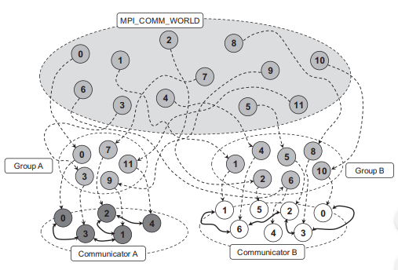

Slide 30
To create an MPI application it is necessary to define the code for the MPI process that will be executed in parallel.
A common model used in MPI is the master-worker model, whereby one MPI process (usually the one with rank 0) coordinates the execution of others that perform the same task.
At present there are several MPI implementations that can be leveraged to develop distributed applications.
One of the most popular MPI software environments (www.mcs.anl.gov/mpi/) is developed by the Argonne National Laboratory in the United States.
MPI has gained a good deal of success as a parallel and distributed programming model for CPU-intensive mathematical computations such as linear systems solvers, matrix computations, finite element computations, linear algebra, and numerical simulations.

Slide 31
Workflow applications with task dependencies
Workflow applications are characterized by a collection of tasks that exhibit dependencies among them.- data dependencies
What is a Workflow?
A workflow is the automation of a business process, in whole or part, during which documents, information, or tasks are passed from one participant (a resource; human or machine) to another for action, according to a set of procedural rules.
Structured execution of tasks that have dependencies- Idea- Scientific Workflow.
A scientific workflow generally involves data management, analysis, simulation, and middleware supporting the execution of the workflow.

Slide 32
A scientific workflow is generally expressed by a directed acyclic graph (DAG), which defines the dependencies among tasks or operations
The nodes on the DAG represent the tasks to be executed in a workflow application;
The arcs connecting the nodes identify the dependencies among tasks and the data paths that connect the tasks.
The most common dependency that is realized through a DAG is data dependency, which means that the output files of a task (or some of them) constitute the input files of another task.
This dependency is represented as an arc originating from the node that identifies the first task and terminating in the node that identifies the second task.

Slide 33
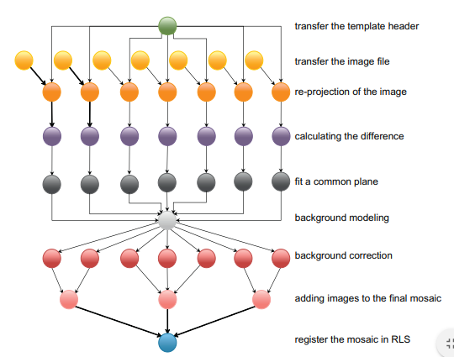
Sample Montage workflow
Montage is a toolkit for assembling images into mosaics;
It has been specially designed to support astronomers in composing the images taken from different telescopes or points of view into a coherent image

Slide 34
Workflow technologies
Business-oriented computing workflows are defined as compositions of services, and there are specific languages and standards for the definition of workflows, such as Business Process Execution Language (BPEL).
Design tools allow users to visually compose a workflow application.
In most cases, the workflow engine is a client side component that might interact directly with resources or with one or several middleware components for executing the workflow
Some frameworks can natively support the execution of workflow applications by providing a scheduler capable of directly processing the workflow specification.
Some of the most relevant technologies for designing and executing workflow-based applications are Kepler, DAGMan, Cloudbus Workflow Management System, and Offspring.

Slide 35





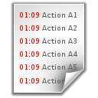

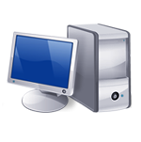




Build Time
Users
Workflow Design & Definition
Workflow Application Modeling & Definition Tools
Information Services
Workflow
Specification
Run Time
Resource Info Service
Application Info Service
Workflow Enactment Engine
Interaction with Information Services
Workflow Execution & Control
Task + Data Scheduler
Data Movement
Dependency Manager
Language Interpreter
Data Provenance
Runtime
Manager
Fault Management
Interaction with Distributed Resources
Middleware Supporting Clusters, Grids, and Clouds
Distributed Computing Resources

Slide 36
Aneka Task-Based Programming
Aneka provides support for all the flavours of task-based programming
Task programming is realized through the abstraction of the Aneka.Tasks.Itask.
Includes:
Task Programming model
Developing applications with the task model
Developing a parameter sweep application
Managing workflows

Slide 37




Task programming model
StorageService
TaskScheduler
AnekaApplication
TaskManager
(… more tasks)
Index
Node
Task1 : ITask
AnekaTask
Task2 : ITask
AnekaTask
Membership
Catalogue
TaskExecution
Service
Aneka Cloud
Local Node

Slide 38
AnekaTask- Runtime wrapper Aneka uses to represent a task within the middleware.
TaskManager: submits the tasks, monitors their execution, and collects the results.
Middleware, four services- MembershipCatalogue, TaskScheduler, ExecutionService, and StorageService.
MembershipCatalogue constitutes the main access point of the cloud and acts as a service directory to locate the Task Scheduler service that is in charge of managing the execution of task-based applications.
Its main responsibility is to allocate task instances to resources featuring the Execution Service for task execution and for monitoring task state.
If the application requires the data transfer support in the form of data files, input files, or output files, an available Storage Service will be used as a staging facility for the application.

Slide 39
Developing applications with the task model
Execution of task-based applications involves several components
The development of such applications is limited to the following operations:
Defining classes implementing the ITask interface
Creating a properly configured AnekaApplication instance
Creating ITask instances and wrapping them into AnekaTask instances
Executing the application and waiting for its completion

Slide 40
Steps involved in developing of applications
ITask and AnekaTask
Controlling task execution
Static and dynamic task submission
Application state and task state monitoring
Event-based notification of task completion or failure.
File Management
Task libraries
File copy
Legacy application Execution
Substitute operation
File deletion
Timed delay
Task composition

Slide 41
Web Service Integration: Aneka provides integration with other technologies and applications by means of Web services, which allow some of the services hosted in the Aneka Cloud to be accessible in platform independent fashion.
Operations supported through the Web service interface are the following:
Local file copy on the remote node
File deletion
Legacy application execution through the common shell services
Parameter substitution

Slide 42
Developing a parameter sweep application
The set of abstractions and tools supporting the development of parameter sweep applications constitutes the Parameter Sweep Model (PSM).
The PSM is organized into several namespaces under the common root Aneka.PSM. More precisely:
Aneka.PSM.Core (Aneka.PSM.Core.dll)
Aneka.PSM.Workbench (Aneka.PSM.Workbench.exe) and Aneka.PSM.Wizard (Aneka.PSM. Wizard.dll
Aneka.PSM.Console (Aneka.PSM.Console.exe)

Slide 43
Aneka.PSM.Core (Aneka.PSM.Core.dll) -contains the base classes for defining a template task and the client components managing the generation of tasks, given the set of parameters.
Aneka.PSM.Workbench (Aneka.PSM.Workbench.exe) and Aneka.PSM.Wizard (Aneka.PSM. Wizard.dll) contain the user interface support for designing and monitoring parameter sweep applications. Mostly they contain the classes and components required by the Design Explorer, which is the main GUI for developing parameter sweep applications.
Aneka.PSM.Console (Aneka.PSM.Console.exe) contains the components and classes supporting the execution of parameter sweep applications in console mode.

Slide 44
Managing workflows
Support for workflow in Aneka is not native but is obtained with plug-ins that allow client-based workflow managers to submit tasks to Aneka.
Currently, two different workflow managers can leverage Aneka for task execution: the Workflow Engine and Offspring .

Slide 45

Offspring Environment
IOffspringPlugin
DefaultPlugin
LogPlugin
AutoPlugin
AppInstance
Strategy
Controller
IDistributionEngine
DistributionEngineBase
ITaskStrategy
Local
Engine
AnekaEngine
TaskStrategyBase
TaskManager
Aneka Cloud
Workflow Logic 1
Workflow Logic N

Slide 46
StrategyController
Control Thread
(Strategy Management)
Monitoring Thread
(Feedback from Distribution Engine)
Task Feedback
Init Application
Init Strategy
Task Failed?
Submit Tasks
No
Yes
Wait
Invoke OnSuccess
Invoke OnFailed
No
Complete or Stop?
New Task?
Yes
Yes
No
Submit
Release Strategy
Signal
Yes
Iteration Complete?
Shutdown Application
No

